Slide 1

Mobile Developer Community Meetup
September 13, 2023

Slide 2

Agenda
Apple App Store Certificates
New mobile developer documentation site
Who we are
What we've been working on
Land acknowledgment
Notes:
Remind: Question period after certificates and documentation

Slide 3
Land Acknowledgement
I would like to acknowledge the land on which I work and is my home is the unceded territory of the Malahat people
I would also like to make a book recommendation
Laughing with the Trickster: On Sex, Death, and Accordions by Tomson Highway
Tomson Highway is a Cree author, playwrite and musician
2022 Massey lecturer
Listen on CBC Ideas Podcast

Slide 4

Who we are and what we do

Slide 5





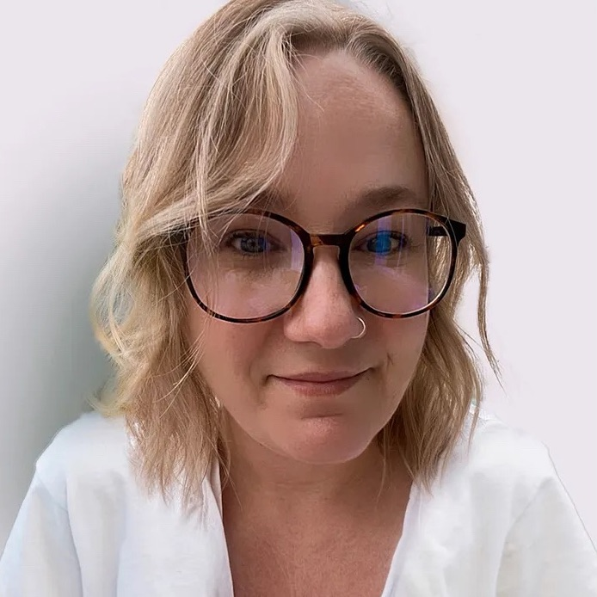
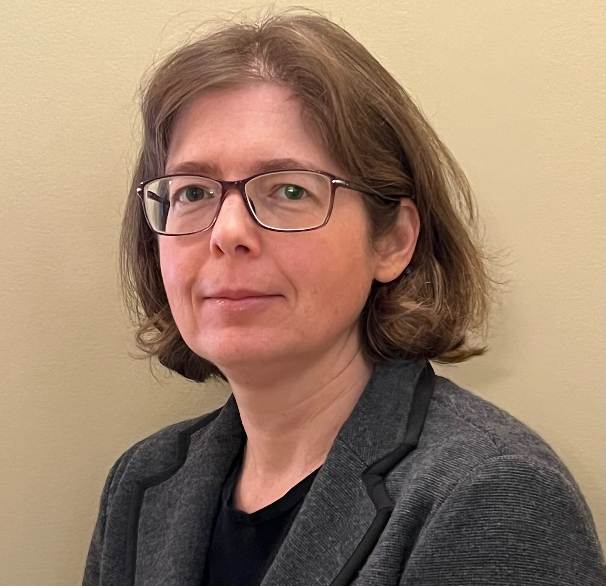

The Developer Experience Team
Karl Hardin Senior Director, Digital Delivery
Jen Reiher Senior Product Manager
Shea Phillips Architect
Shiho Itagaki SaaS Manager
Edson Naves Scrum Master
Martha Edwards Lead Service Designer
Monica Granbois Mobile App Devops Specialist
Galen Gray Technical Community Manager
Notes:
Note new employees since last meeting

Slide 6
What we’re working on
Updated the Apple App Store Name
Was: His Majesty the King in the right of the Province of BC
Now: Government of British Columbia
Updated mobile developer documentation
Demo later in presentation
Meet with new teams curious or ready to create a mobile app

Slide 7

Apple Certificates
This Photo by Unknown Author is licensed under CC BY-NC

Slide 8
Certificate Expiry Dates
Developer Program Certificate
Expires on Oct 3, 2023
Enterprise Program Certificate
Expires Oct 5, 2024 (Next year)

Slide 9
What happens if an app uses an expired certificate?
Your app will still be available on the App Store
Your app will still be usable by your users
You must upgrade to the latest certificate to upload new versions of your app
Notes:
Note: This for App Store certificates only! Not Enterprise program!

Slide 10
Certificate Distribution Changes
Previous Methods
CI/CD Pipeline
Email certificate to developers
Fall 2023 Methods
XCode managed certificates
CI/CD Pipeline
Email certificate to developers
Prefer first 2 options
New

Slide 11
XCode managed certificates
Why?
For teams not using CI/CD
Less friction in onboarding developers and teams.
You are not waiting on the Developer Experience team to send you the certificate and provisioning profile
We are not emailing certificates and passwords around
New signing certificates are automatically created 90 days before expiration

Slide 12
How to use XCode Managed Certificates
You can turn on XCode Manage Certificates at anytime
2 steps
App Managers: Give permission to your developers to “Access Cloud Managed Distribution Certificates”
Developers: In XCode select “Automatically manage signing.” in the Signing Page

Slide 13
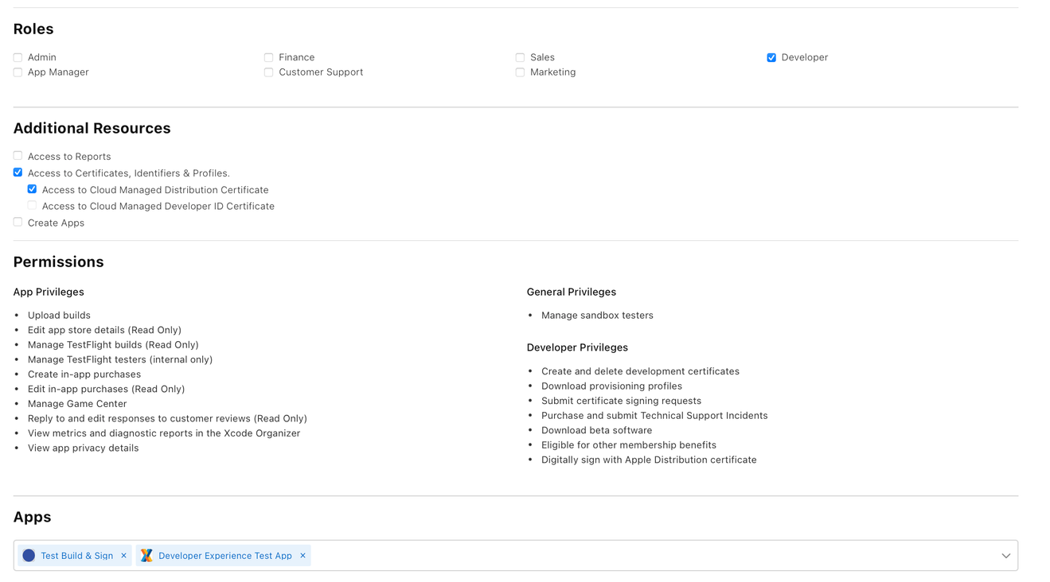
App Store Connect Permissions
App Managers:
In App Store Connect:
Go to Users And Access Menu
Select your developer
Under Additional Resources select “Access to Cloud Managed Distribution Certificate
Notes:
Note the “Digitally sign with Apple Distribution certificate” privledges

Slide 14
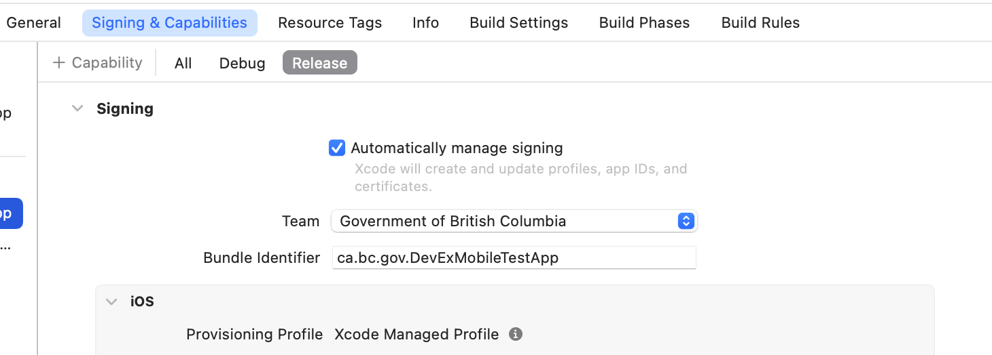
XCode Signing Option
Developers
In XCode:
Go to Signing & Capabilities tab
Select “Automatically manage signing”
Select “Government of British Columbia” as the team

Slide 15
GitHub Actions CI/CD Certificate: Developer Experience Actions
Update the following bcgov GitHub organization’s secrets:
BUILD_CERTIFICATE_BASE64
IOS_BUILD_CERTIFICATE_PASSWD
Create a new provisioning profile for your app
Updates will happen on Wednesday, Sept 20th
Notes:
IF the 20th doesn’t work, please let me know!

Slide 16
GitHub Actions Certificate: Mobile Dev Team Actions
Teams that use GitHub Actions will need to do the following:
App Managers: Download the new provisioning profile from https://developer.apple.com
Update your GitHub Action to use the new provisioning profile
Contact the Developer Experience team (Developer.Experience@gov.bc.ca) if there are issues downloading your provisioning profile

Slide 17
Email Certificates to developers
We will support those projects that are not able to use the previous two methods
Please email us at Developer.Experience@gov.bc.ca if you would like the certificate to be emailed to you
Notes:
Note: Aware of projects using CI/CD outside of GitHub, we will send you the certificate

Slide 18

Questions

Slide 19

Mobile Developer Documentation

Slide 20
Mobile Developer Documentation
The mobile starter kit and wiki documentation has been rewritten into one source
The new documentation is at: https://mvp.developer.gov.bc.ca
This is part of a broader rewrite of the current DevHub site

Slide 21
Documentation Update
This is the first draft of the new documentation
If anything is missing/unclear/wrong, please let us know!
Contact us at Developer.Experience@gov.bc.ca
OR …

Slide 22
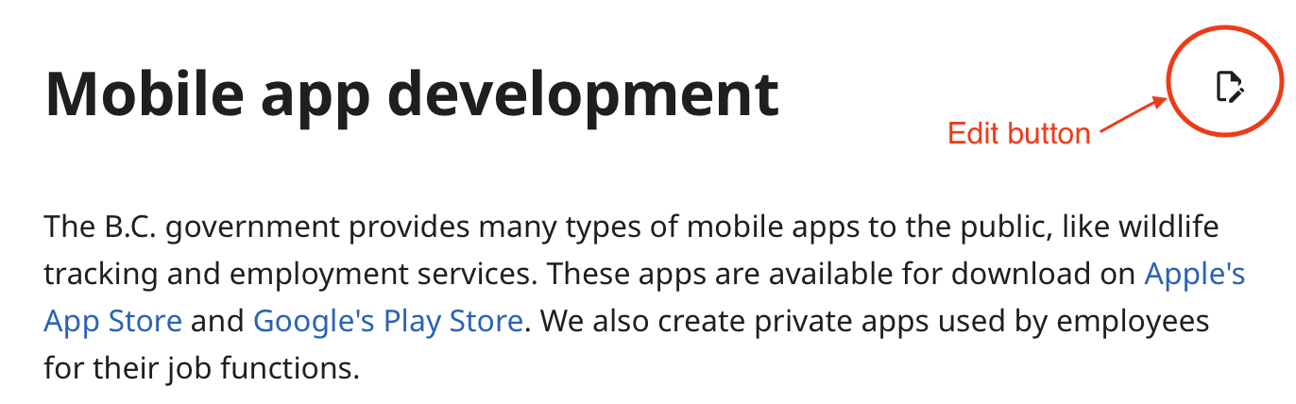
Create a PR for updates
Do you see something in the docs you want to fix?
You can create a pull request by clicking on the edit symbol by the title

Slide 23
Enterprise Development
We have not included Enterprise Development in the documentation
We are working with Apple to learn the best approaches for delivering internal apps
We will work with enterprise program teams over the next year on how to manage/develop internal apps

Slide 24

Questions
Notes:
Next meetup: Spring 2024

Slide 25
Next Meetup
January 2024

